Slide 1
Biology 101: Physiology: Intro & Digestive System
SECTION 02
DR. ANAND
MARCH 15, 2017

Slide 2
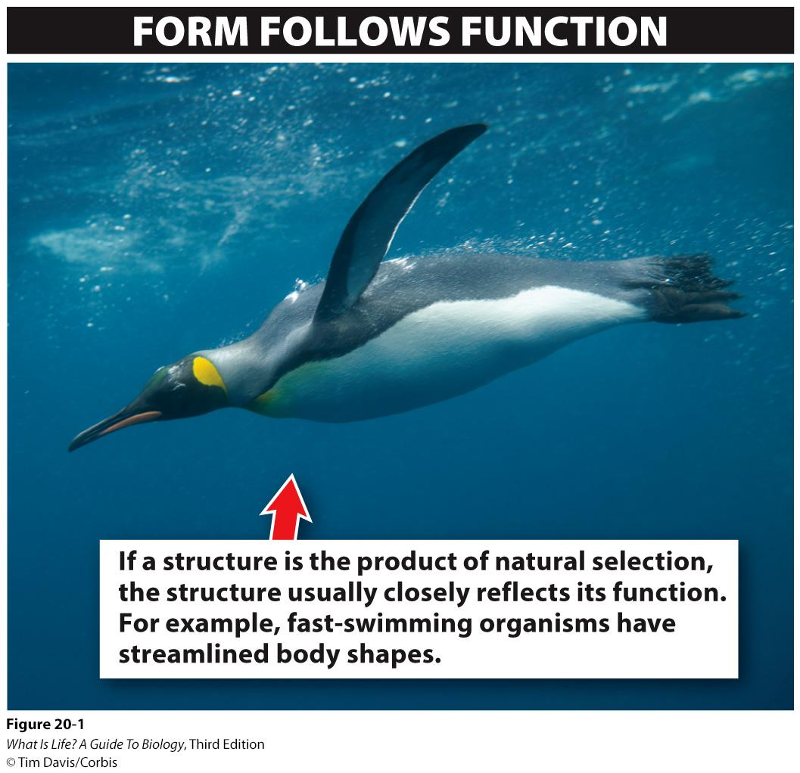
Physiology & Anatomy
Physiology = study of the functions & processes performed by living organisms
Anatomy = study of the structures in living organisms
Often studied together

Slide 3
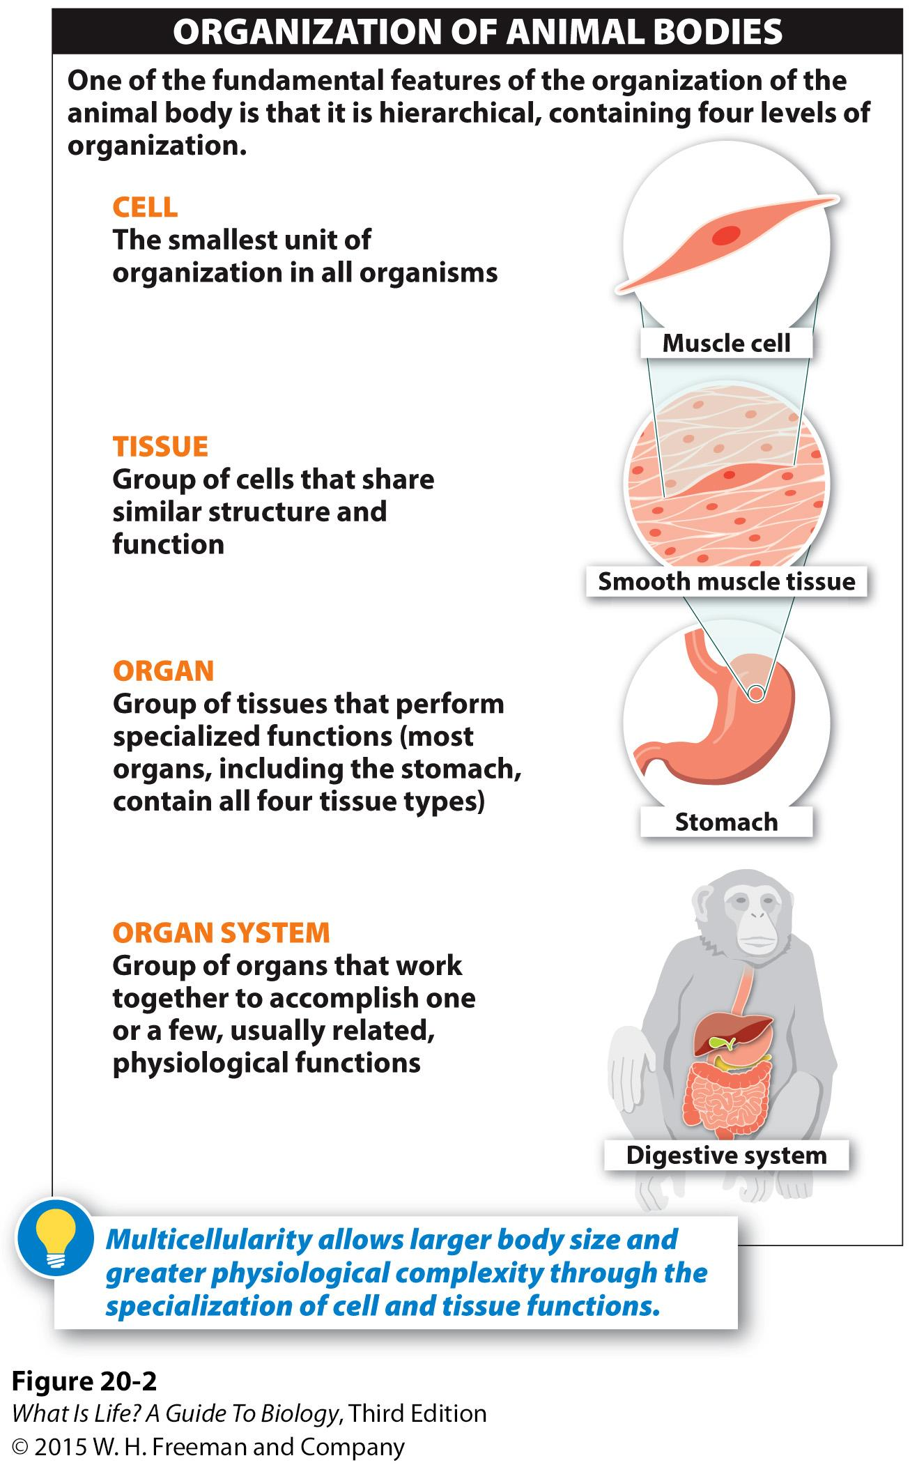
Levels of organization
Organs are groups of cells that perform a specific function
Usually composed of different types of tissues
Some organs perform multiple functions
e.g., heart, liver
Organ systems are groups of organs that together perform a complete function
e.g., digestive tract, respiratory system

Slide 4
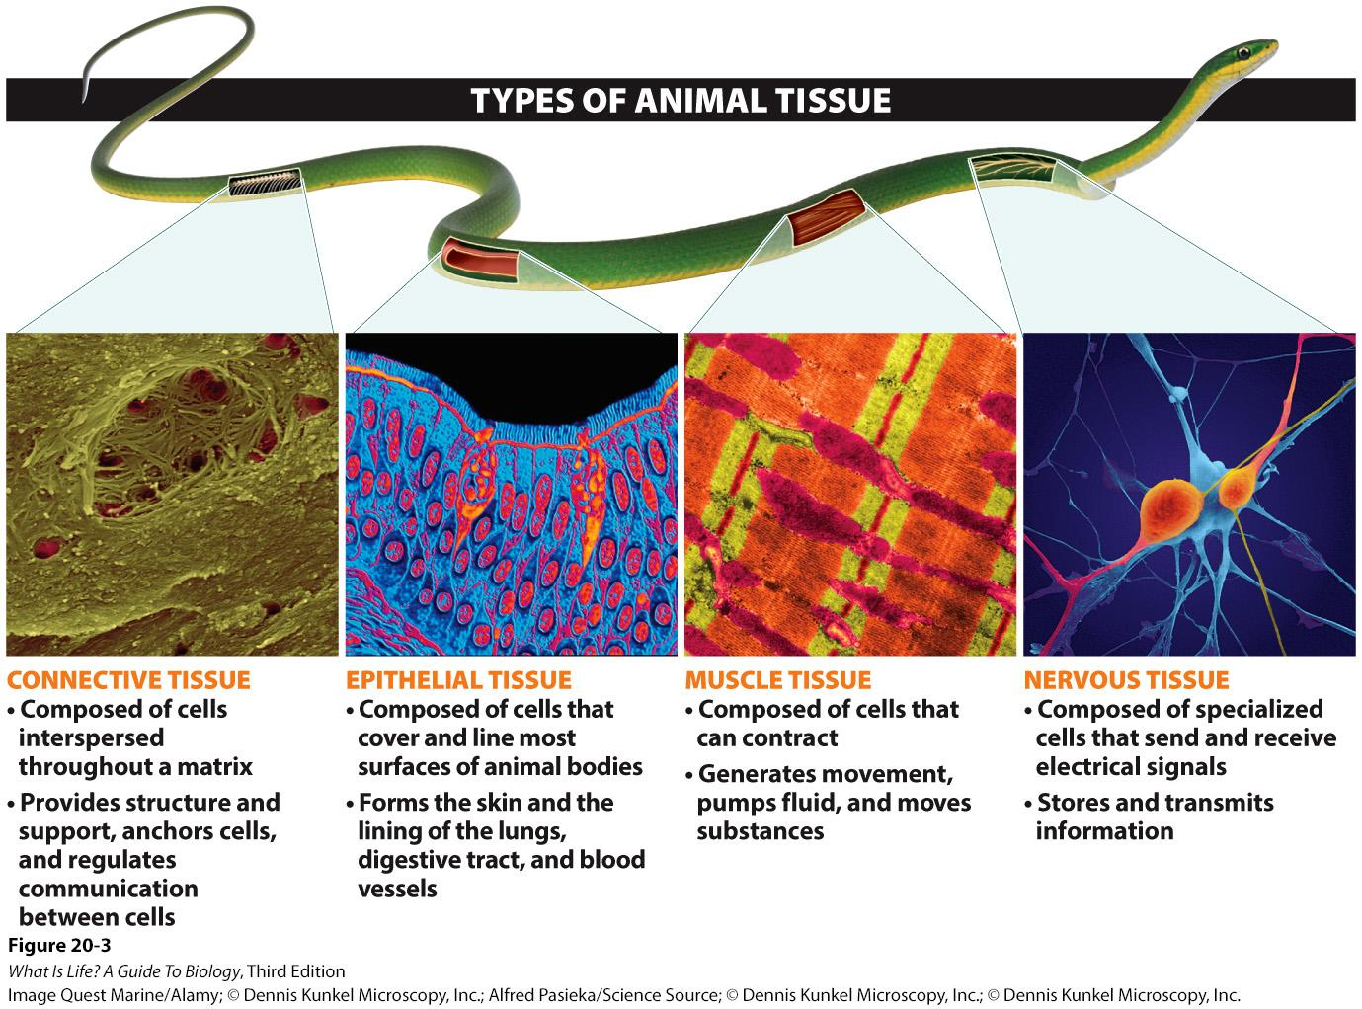
Types of Animal Tissue

Slide 5
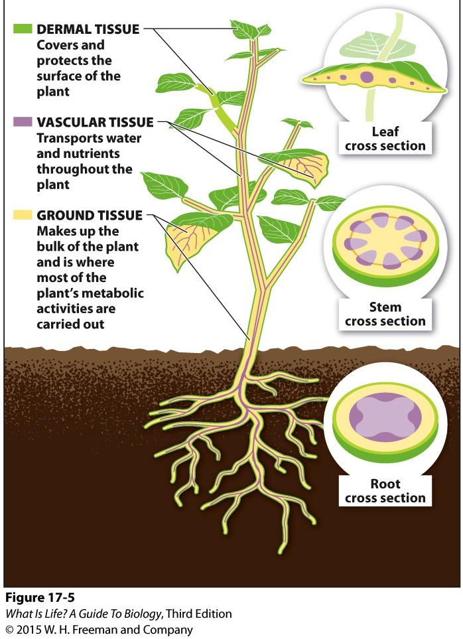
Plant Tissues
Dermal tissue → performs similar function to epithelial tissue in animals
Vascular tissue → tissue that performs a function similar to circulatory system in animals
Ground tissue → somewhat similar function to connective tissue in animals, but it involves functions that are fulfilled by multiple types of tissue in animals

Slide 6
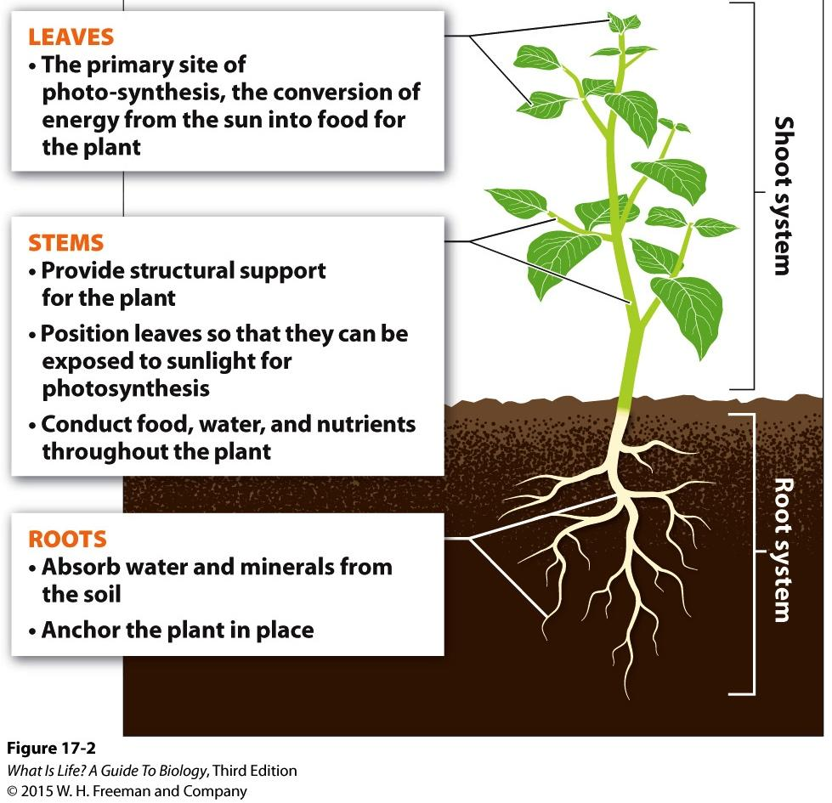
Plant Organ Systems
3 key organs organized into 2 systems
Shoot system
Generally above ground
Leaves
Stems
Root system
Generally below ground
Roots

Slide 7
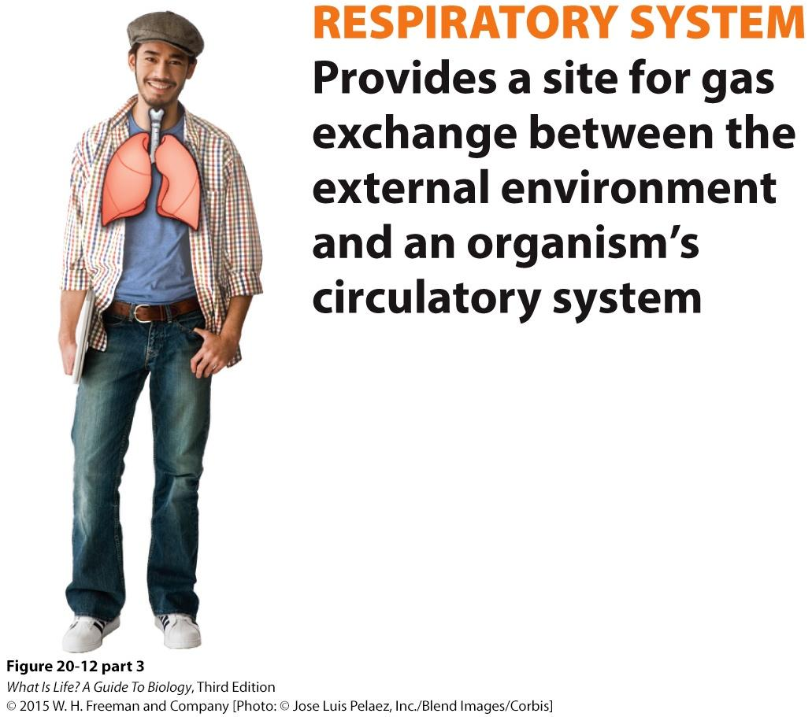
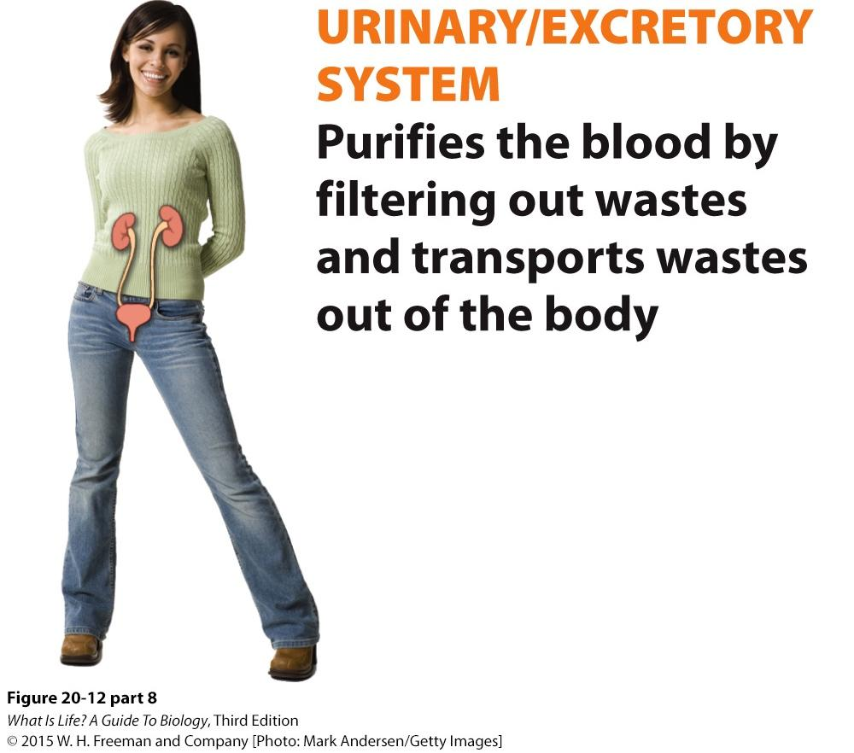
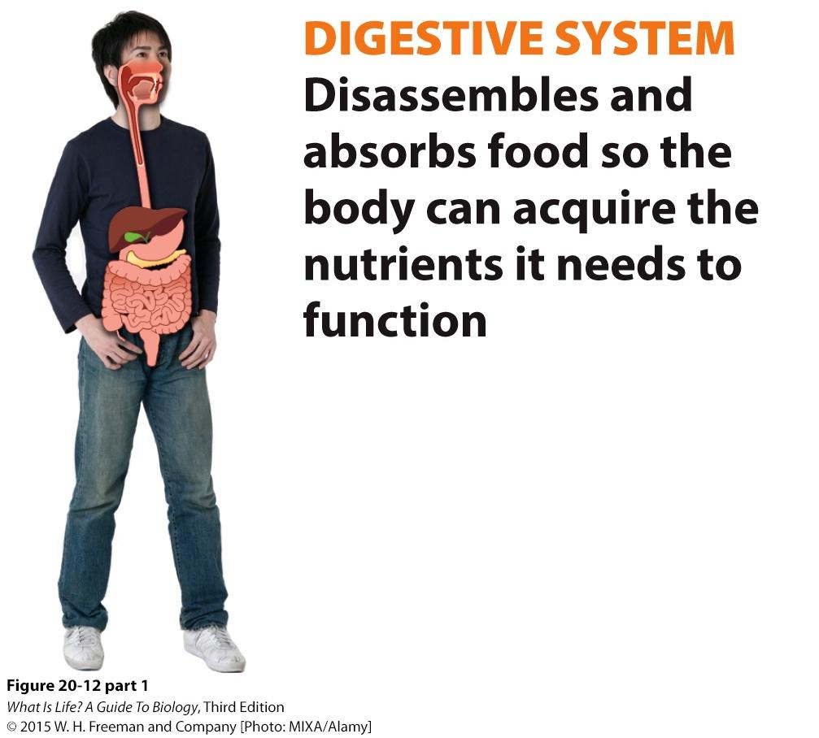
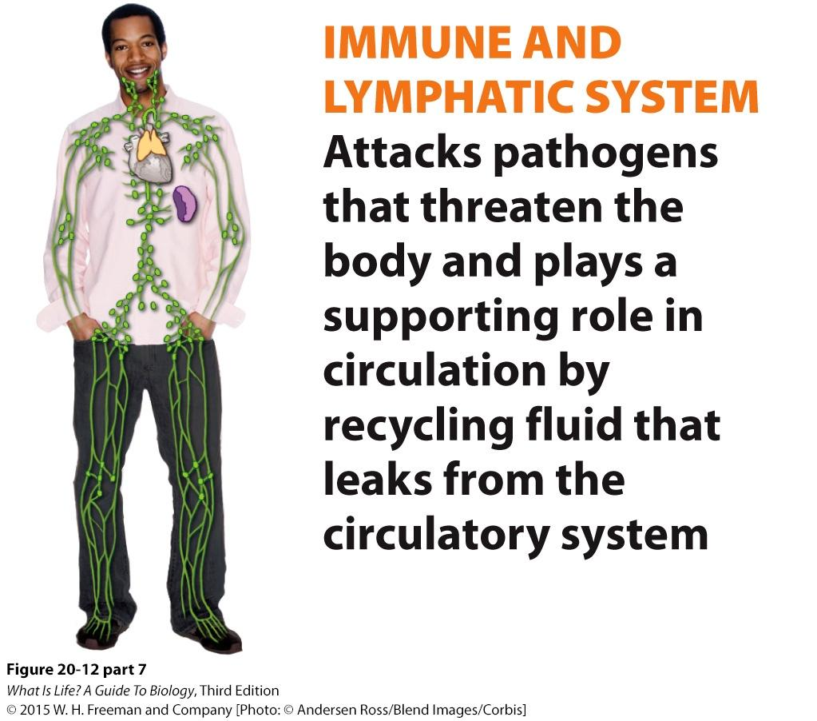
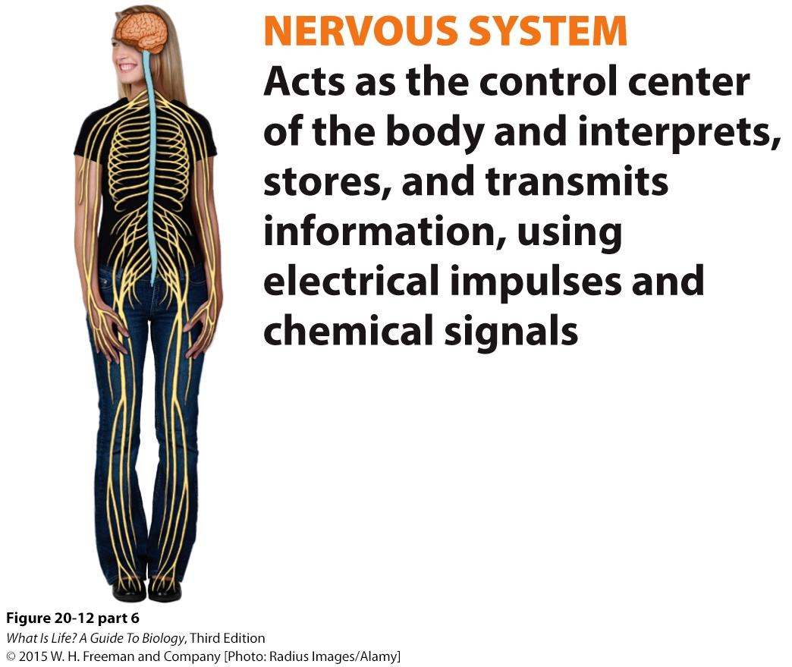
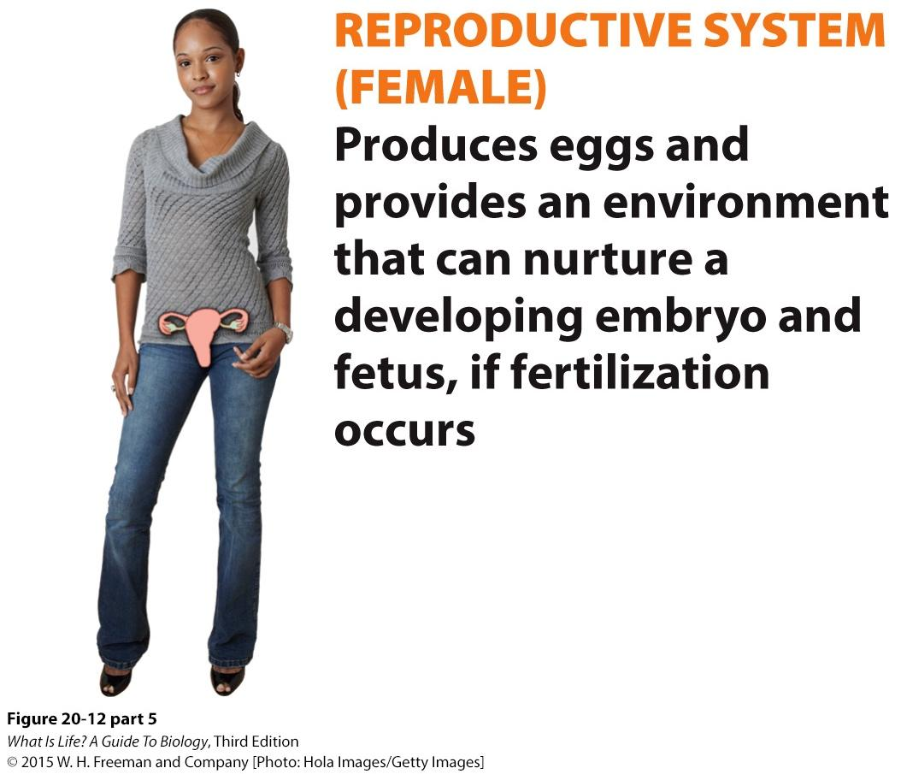
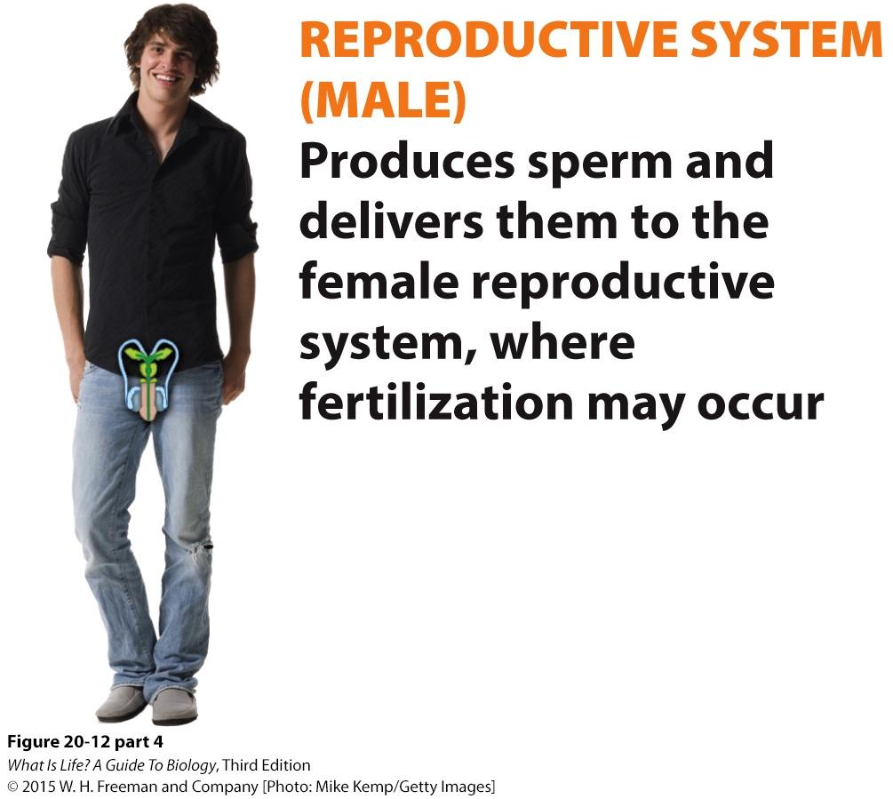
Basic Functions: All Organisms
Gas exchange → Respiratory system
Water balance → Urinary/Excretory system
Nutrient processing → Digestive system
Fight invasion → Immune system
Sense & respond to environment → Nervous system
Reproduce → Reproductive system
ALL organisms need to perform these functions, but have different ways of doing so
For animals, we’ll focus on mammalian (including human) organ systems that perform these functions

Slide 8
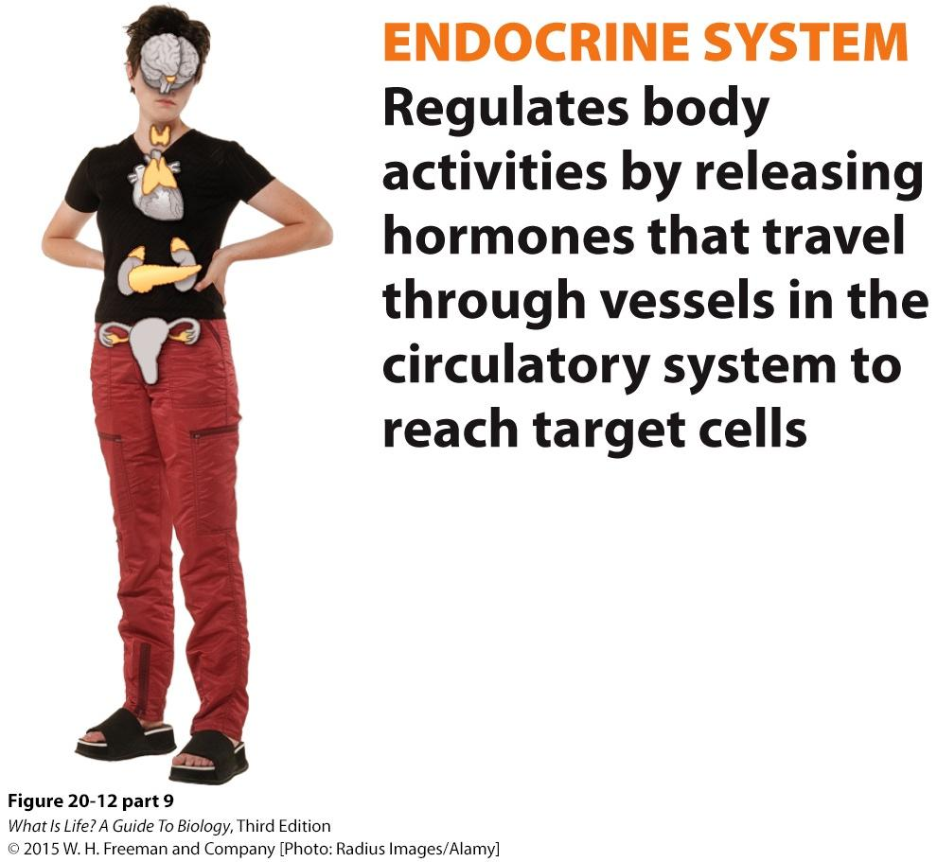
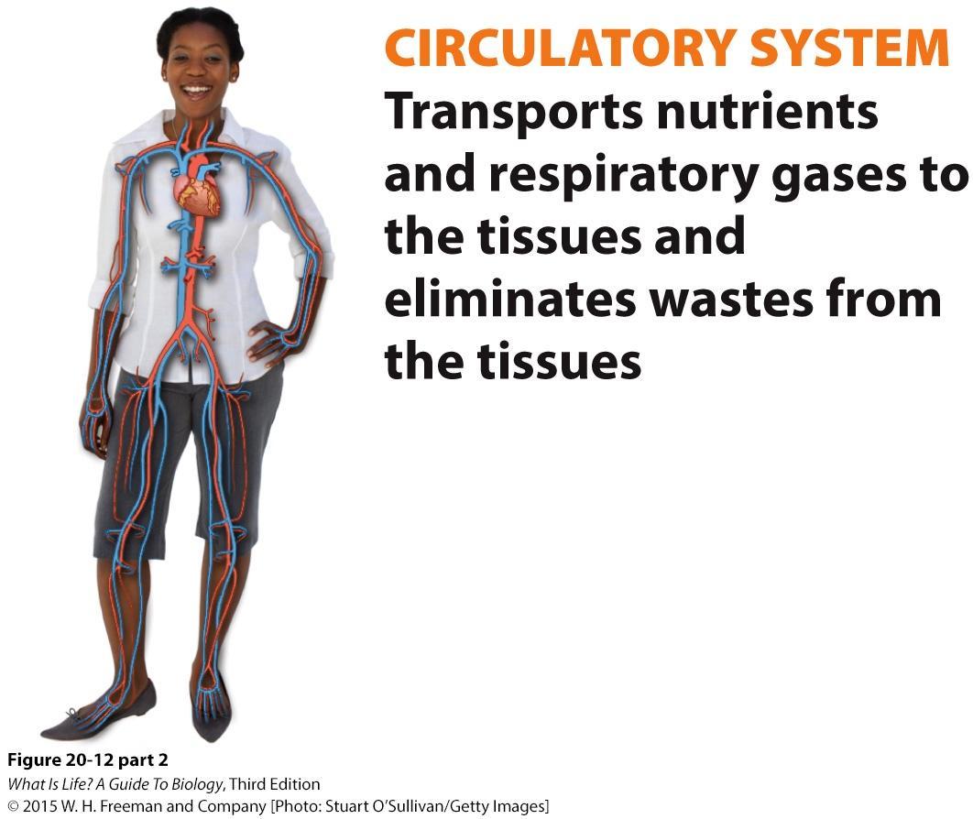
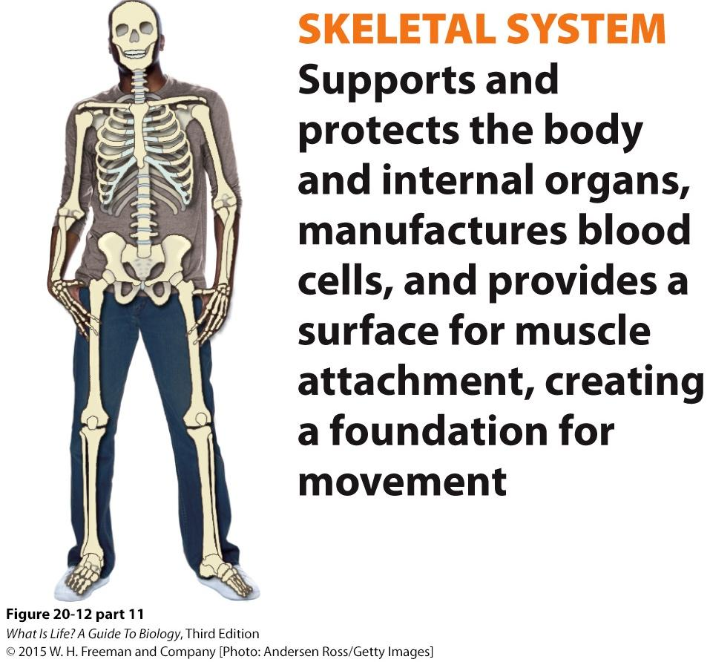
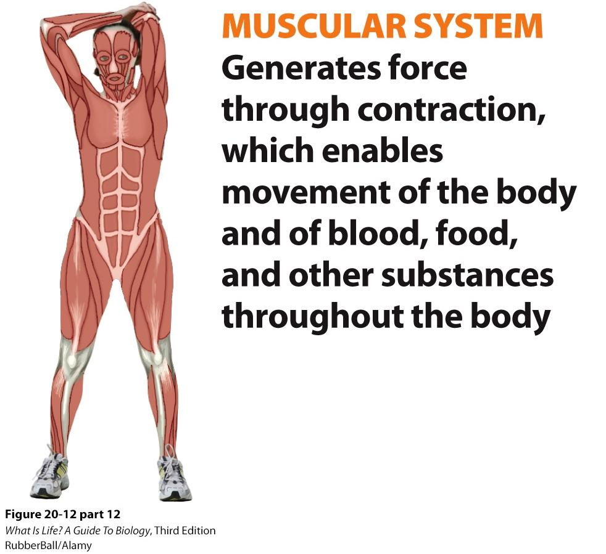
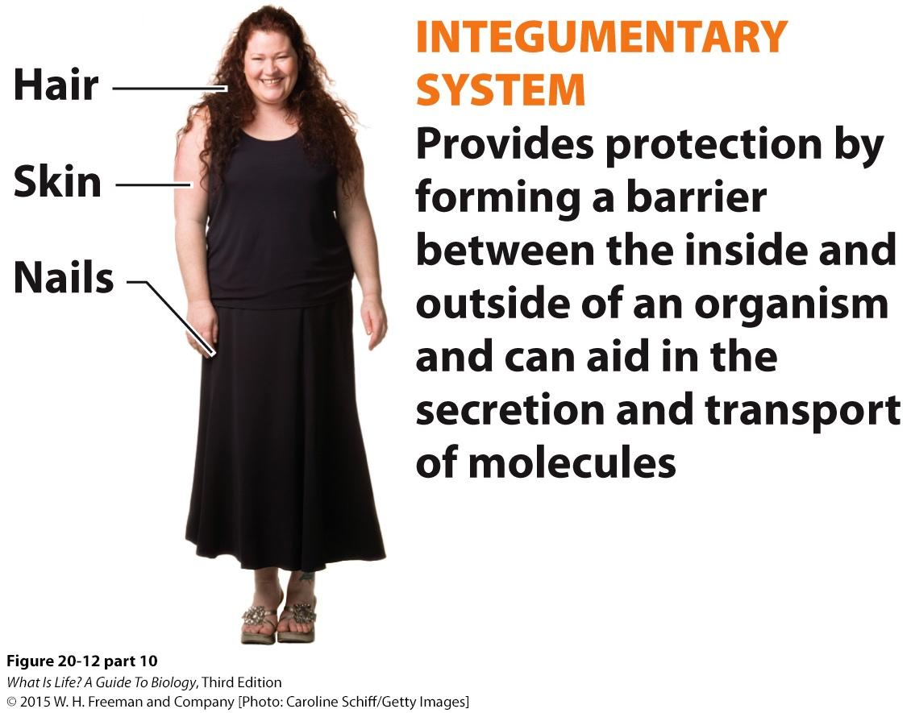
Multicellular Functions
Multicellular organisms face additional challenges & need to have systems to meet these challenges
Again, for animals, we’ll focus on mammalian organ systems
Communicate between cells → Endocrine system
Transport materials → Circulatory system
Maintain structure → Skeletal system
Move → Muscular system
Protect the interior → Integumentary system
Functions provided by multiple organ systems
Manage internal temperature
Balance extra-cellular fluids

Slide 9
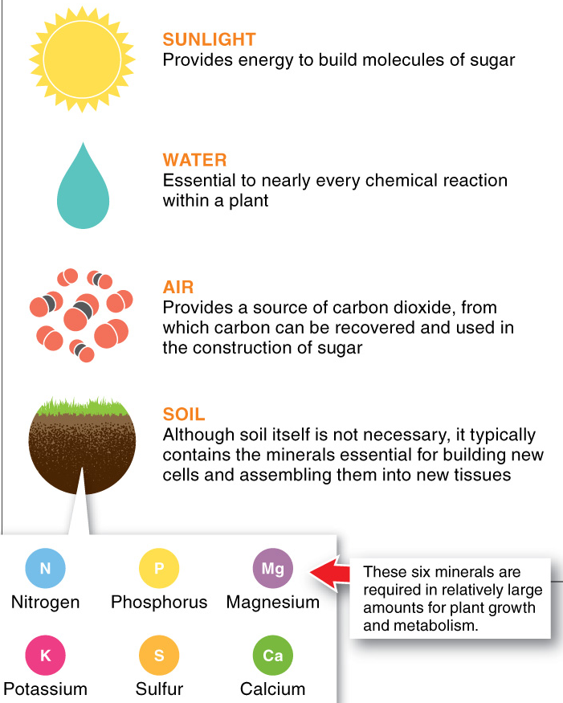
Nutrient Processing
Organs in animal digestive systems are organized to focus on digesting, extracting & storing particular nutrients
Can have one-way or two-way systems
Different animals have organ systems capable of digesting different materials, e.g., ruminants, such as cows, can extract nutrients from cellulose, but humans cannot
Although plants synthesize their own food via photosynthesis, still need to absorb vital nutrients from soil
Most root systems have symbiotic relationships with fungi or bacteria that improve absorption of nutrients
Carnivorous plants have structures that attract & capture animals in nutrient-poor soils Venus Fly Trap

Slide 10
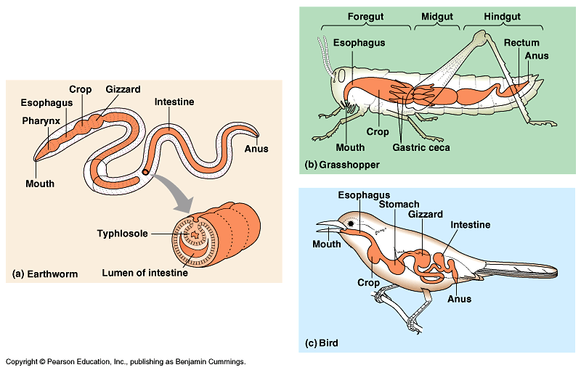
Digestive systems
Everybody’s got one!

Slide 11
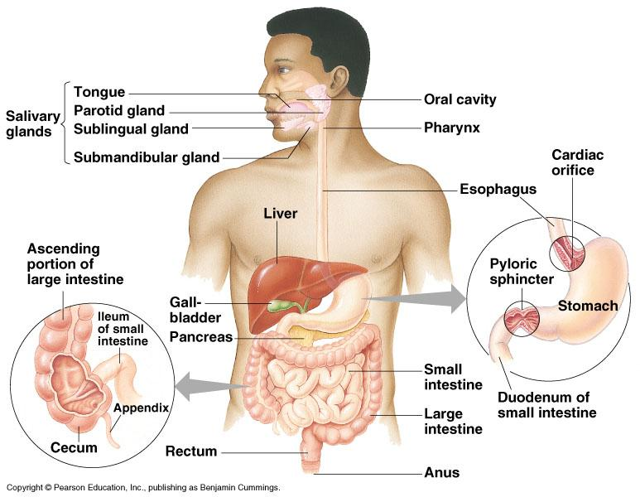
Human digestive system

Slide 12
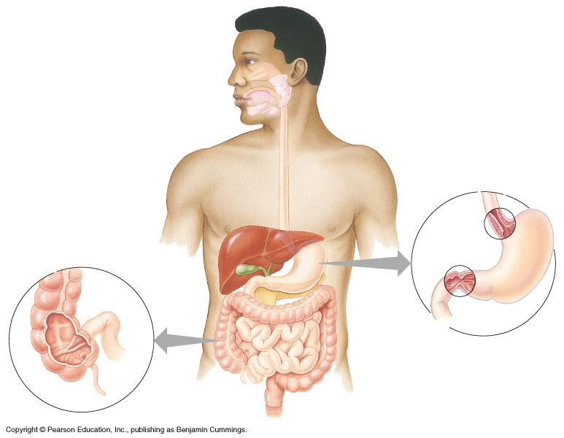
mouth
▪break up food
▪digest starch
▪kill germs
▪moisten food
stomach
▪kills germs
▪break up food
▪digest proteins
▪store food
liver
▪produces bile
- stored in gall bladder
▪break up fats
small intestines
▪breakdown food
- proteins
- starch
- fats
▪absorb nutrients
pancreas
▪produces enzymes to
digest proteins & starch
large intestines
absorb water
Vestigial Organ: Appendix
Rectum

Slide 13
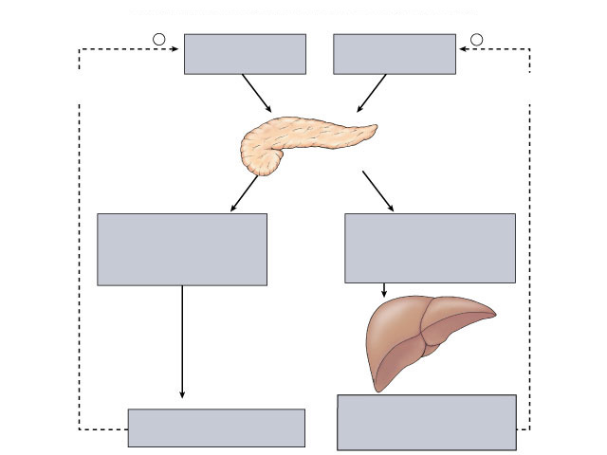
Homeostasis
insulin
body cells take up sugar from blood
liver stores sugar
reduces appetite
pancreas
high
liver
blood sugar level
low
liver releases sugar
triggers hunger
pancreas
Feedback
liver
glucagon

Slide 14
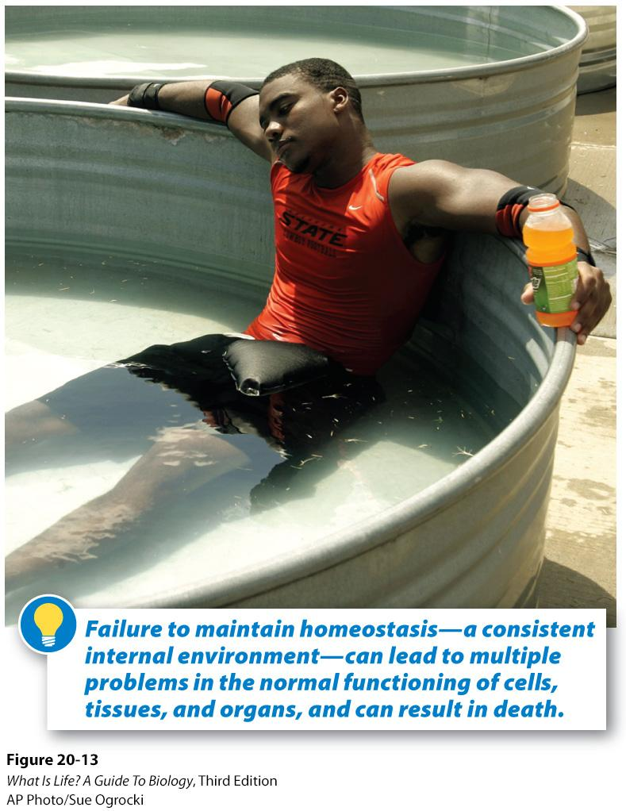
Homeostasis
Homeostasis = Maintenance of internal equilibrium by a variety of physiological means
Basic process:
Sense
Integrate information
Act
Multiple organ systems involved

Slide 15
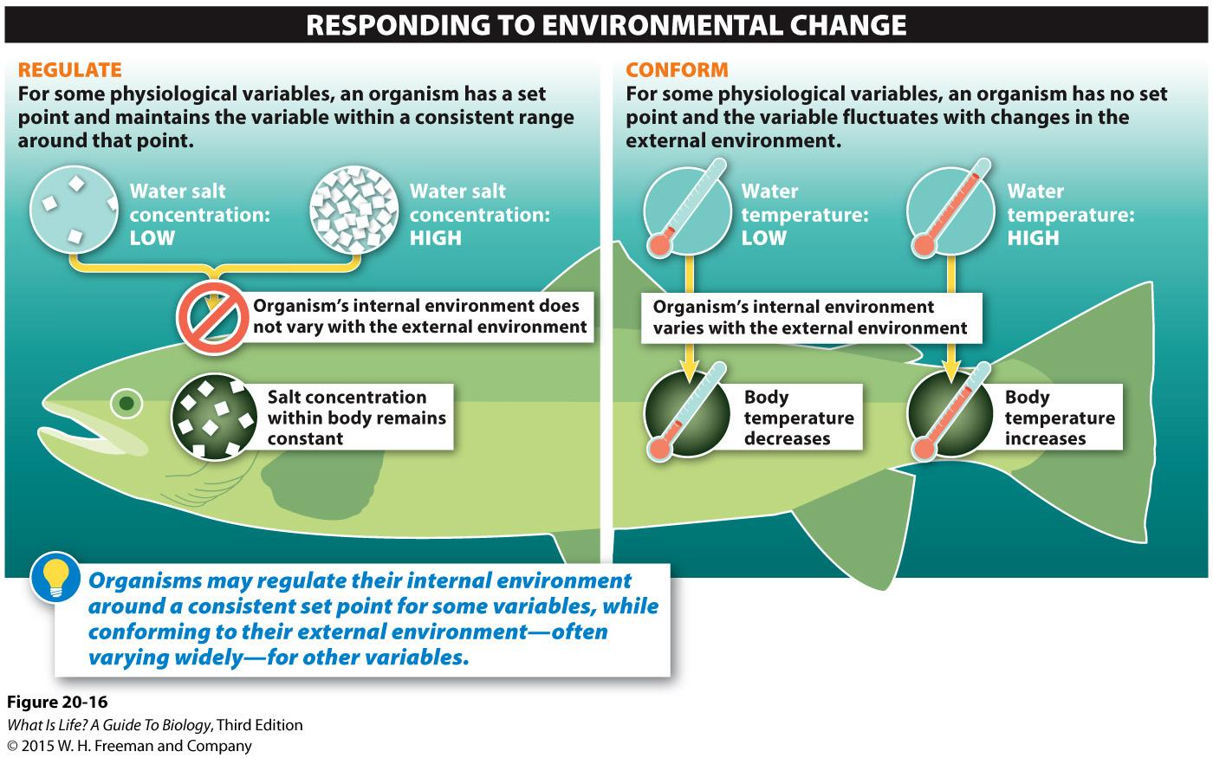
Key Aspects of Homeostasis
Three key variables:
Temperature
Water balance
Fluid balance
Multiple organ systems involved
Fluid balance strongly tied to water balance
Water balance strongly tied to temperature

Slide 16
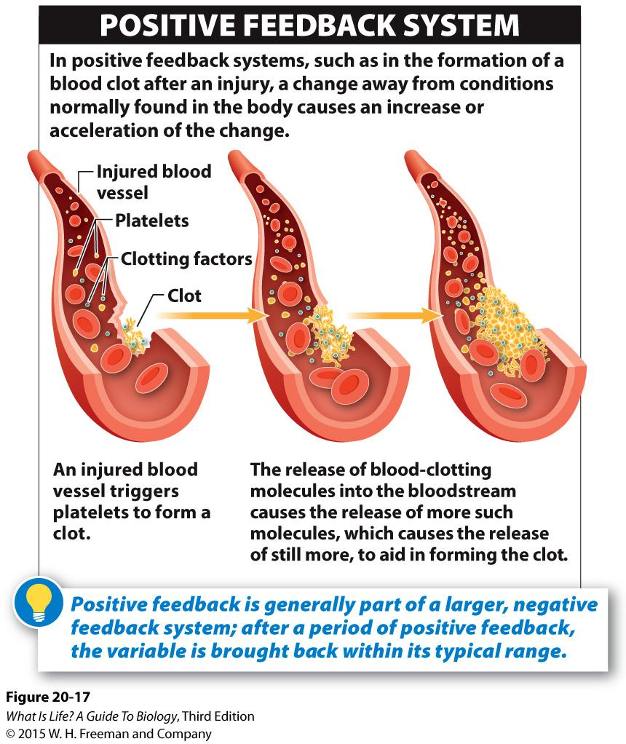
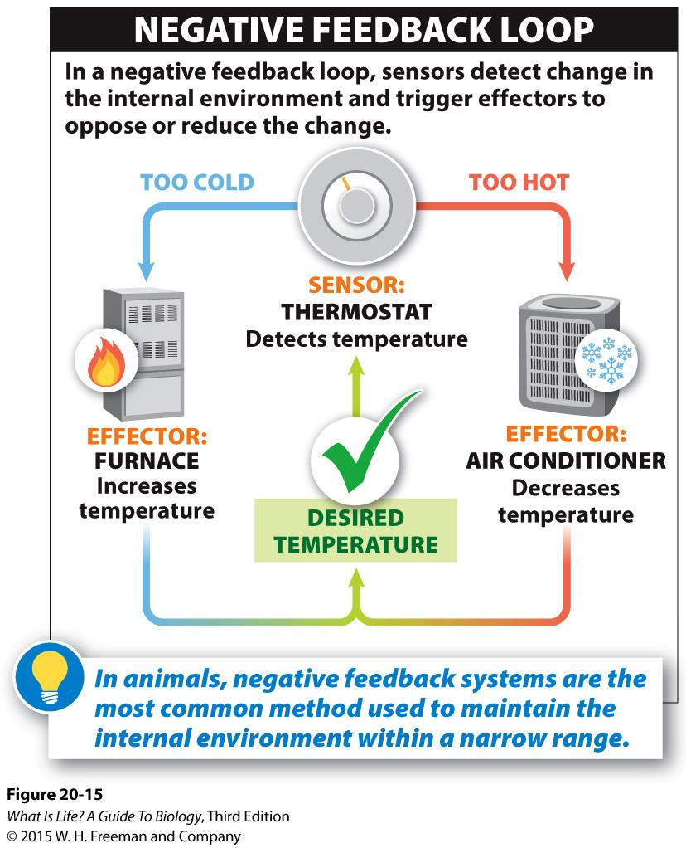
Feedback Systems
Positive Feedback
Negative Feedback

Slide 17
Daily Study Guide
A: Explain how an organism maintains homeostasis
Define homeostasis
Compare & contrast how positive & negative feedback systems are used to maintain homeostasis
Compare & contrast how different organisms use regulating or conforming mechanisms to control key variables
B: Organize functions within levels and explain relationships between levels of biological organization (cell, tissue, organ, organ system, organism)
Define physiology and anatomy, and explain the difference between the two
Explain the basic functions that must be performed by all organisms
Describe the additional functions that multicellular organisms must perform
C: Digestive System: Know the important parts and their functions

